Slide 1
Hash Tables

Slide 2
Key Terms
Hash functions
Modular etc
Hash codes (Values generated from Hash functions)
Collision Solving Techniques
separate chaining
Open addressing
Linear probing

Slide 3
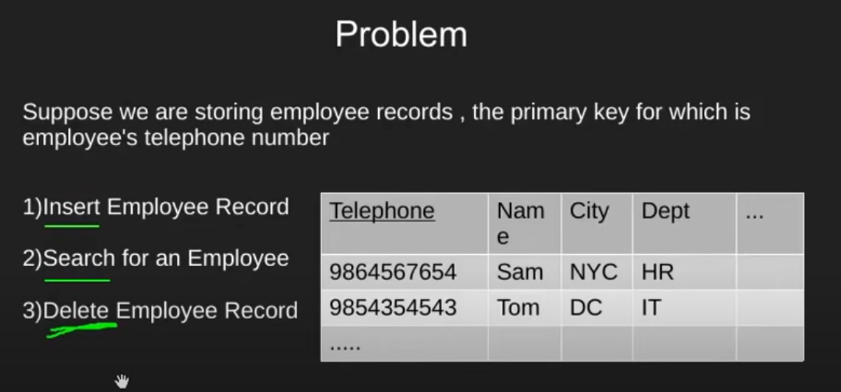
Problem
Notes:
How to do insert, search and delete efficiently?

Slide 4
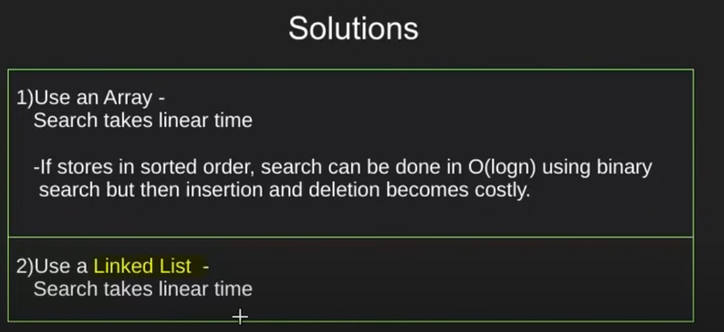
Solutions

Slide 5
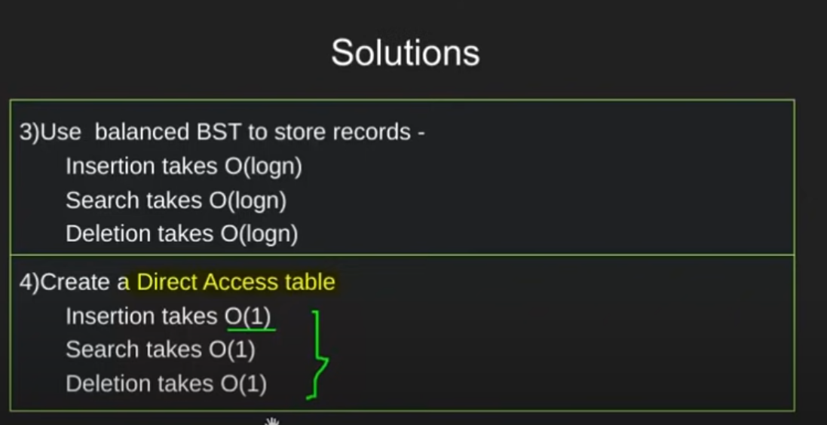
Solutions

Slide 6
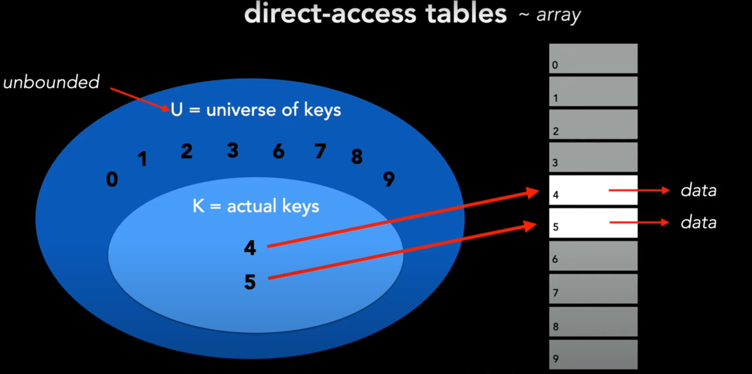
Direct Access table
Notes:
Issues:
Because is unbounded (unlimited) so its not good so size of table is big
The integer variable number we want to save be really big so we cant store that huge number in integer

Slide 7
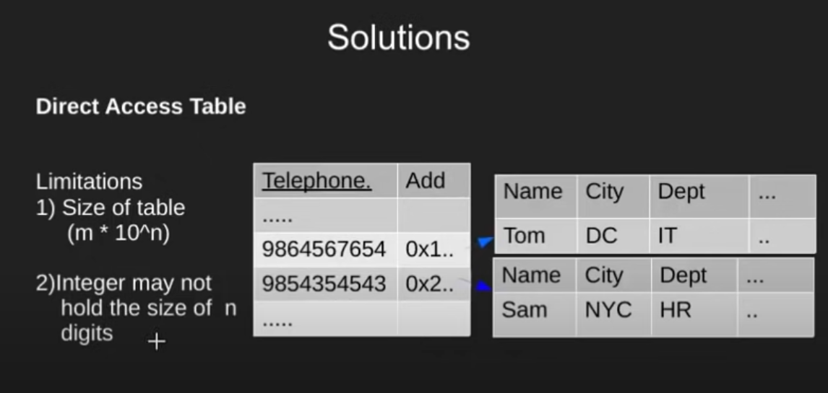
Direct Access table

Slide 8
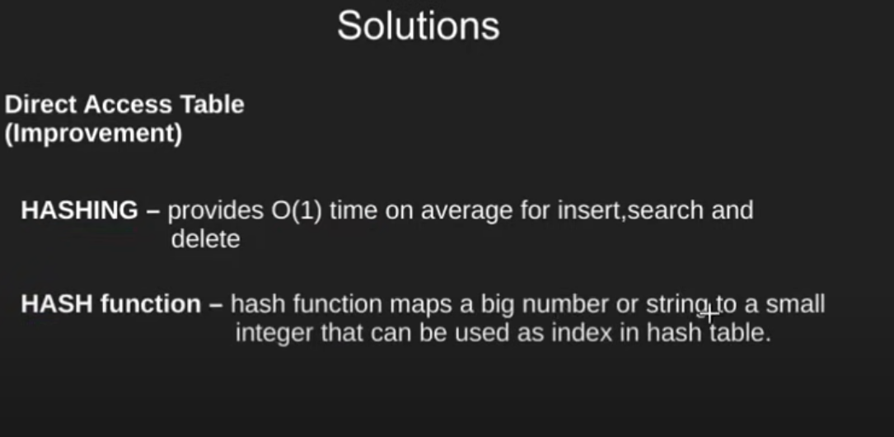
Hash function (module)

Slide 9
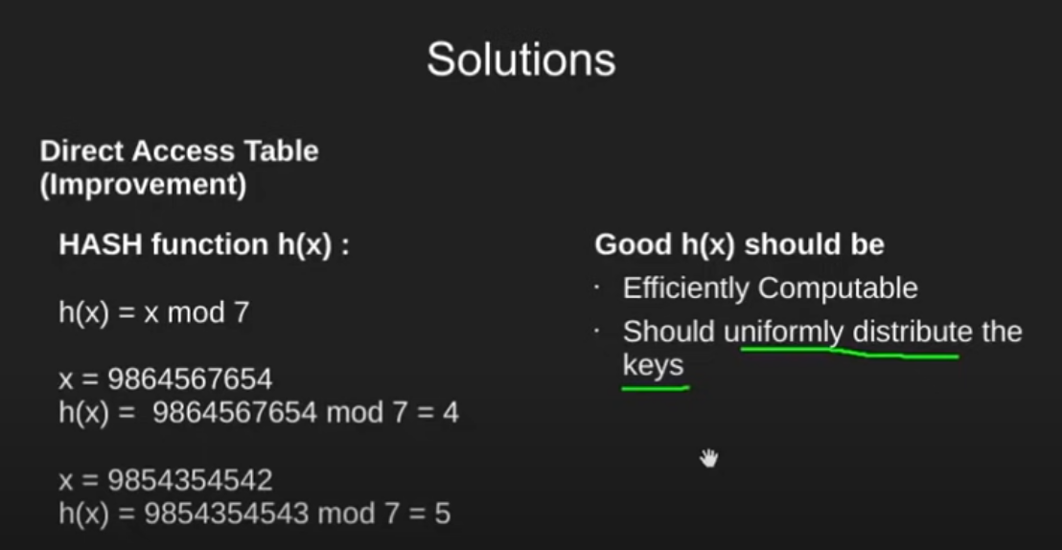
Hash function (module)

Slide 10
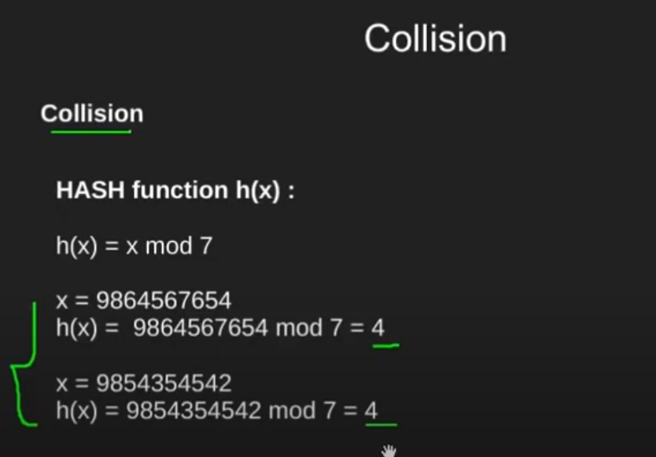
Collision

Slide 11
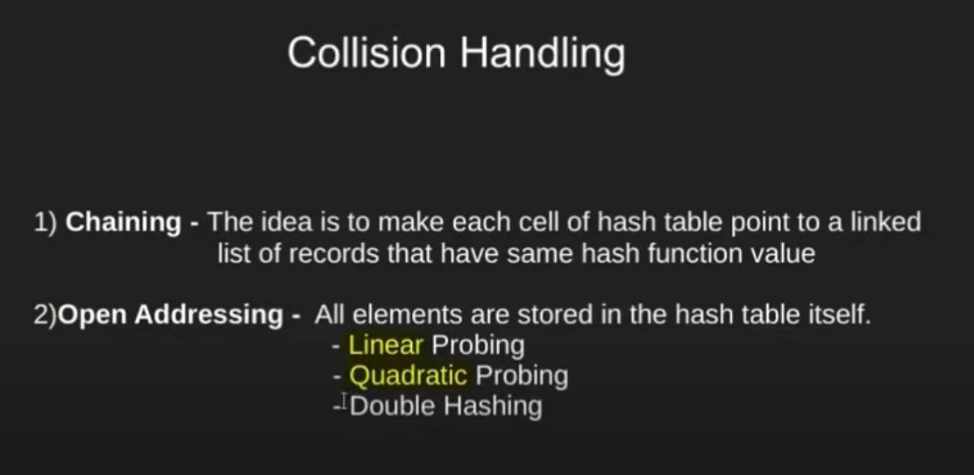
Collision Solution

Slide 12
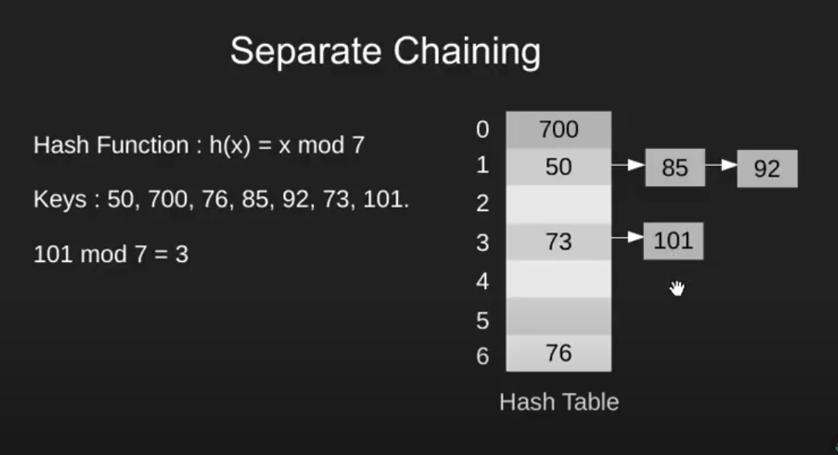
Separate Chaining

Slide 13
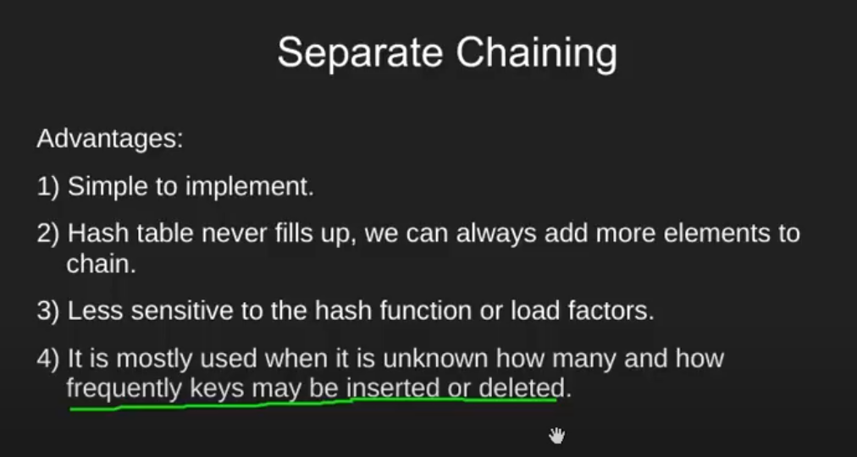
Separate Chaining

Slide 14
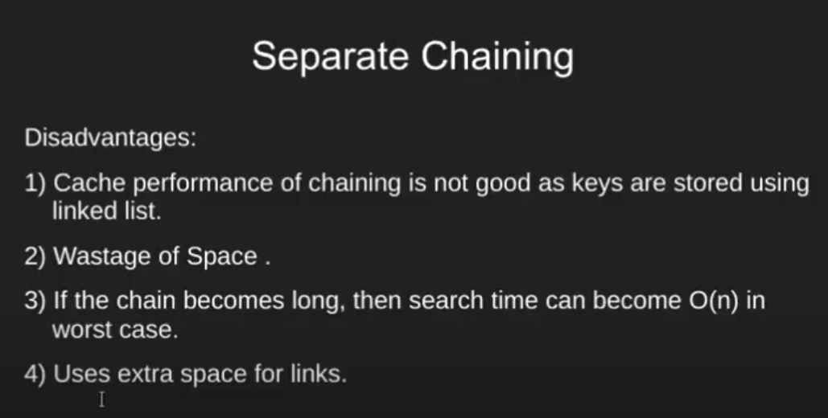
Separate Chaining

Slide 15
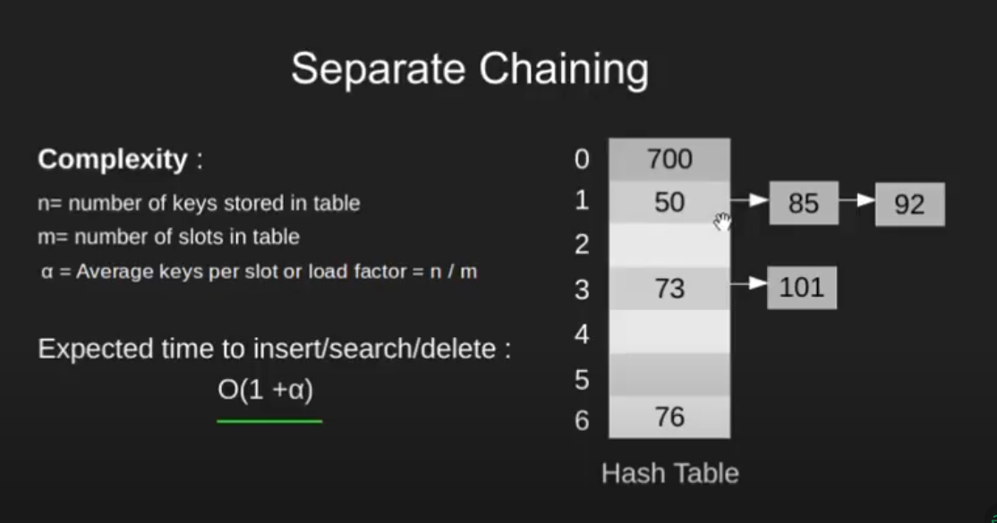
Separate Chaining

Slide 16
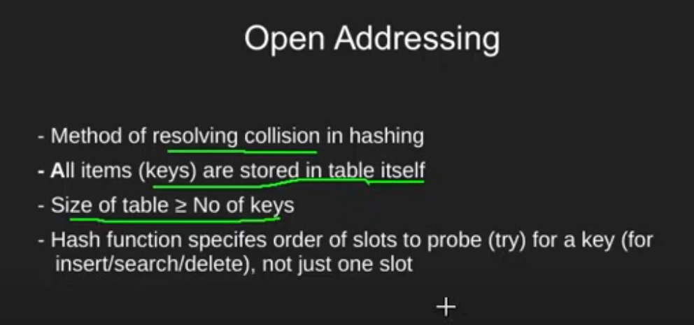
Open Addressing

Slide 17
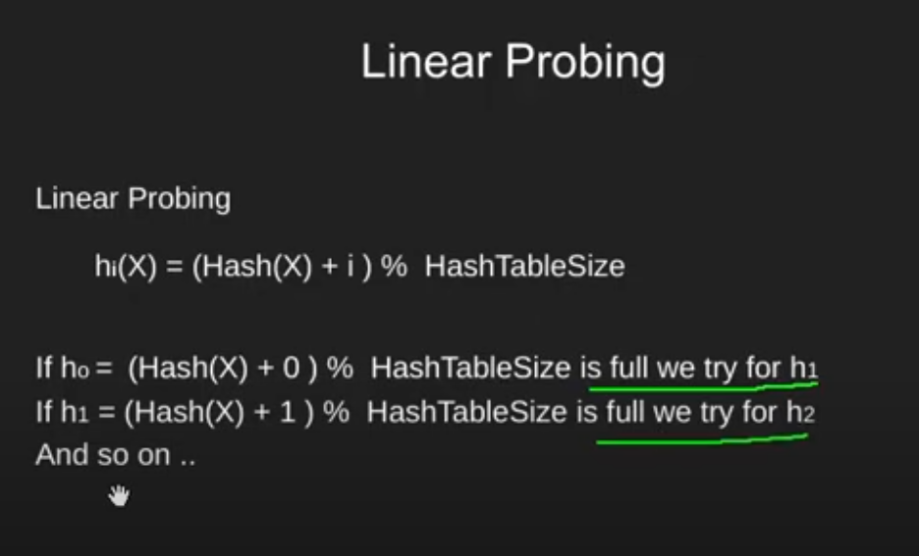
Linear Probing

Slide 18
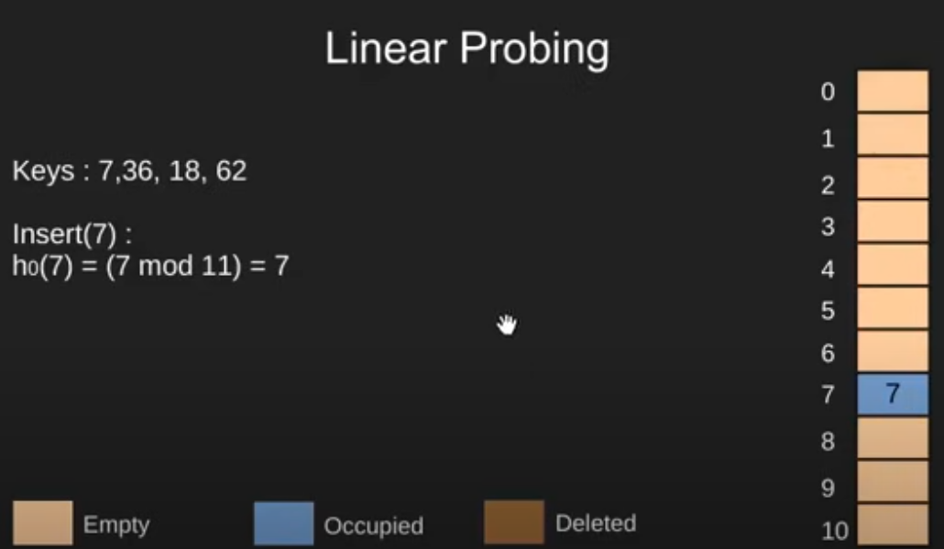
Linear Probing

Slide 19
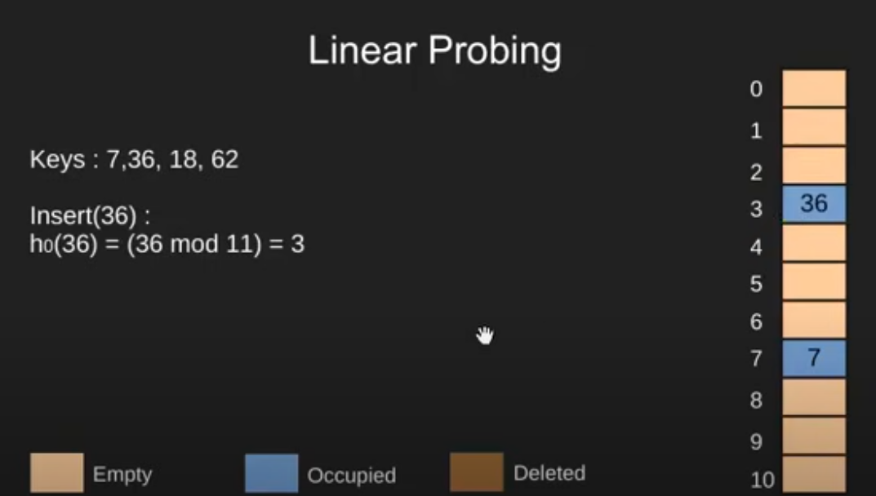
Linear Probing

Slide 20
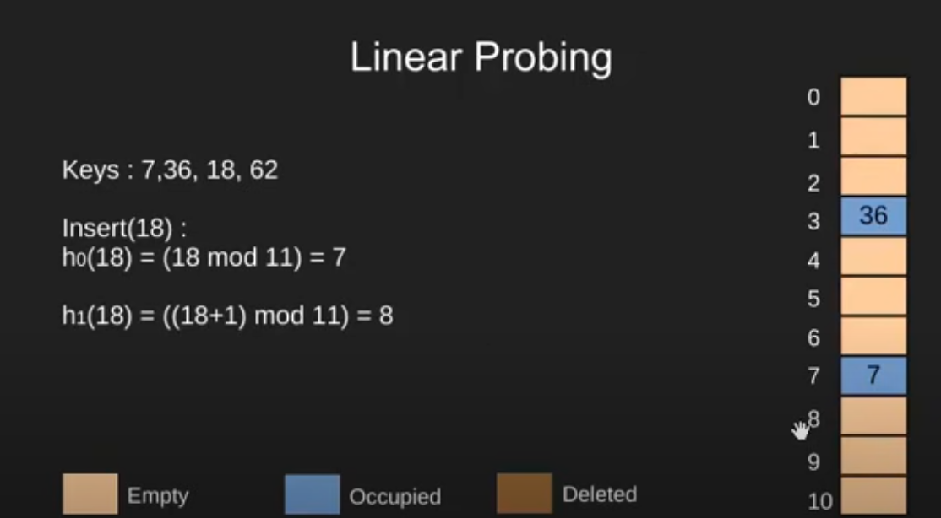
Linear Probing

Slide 21
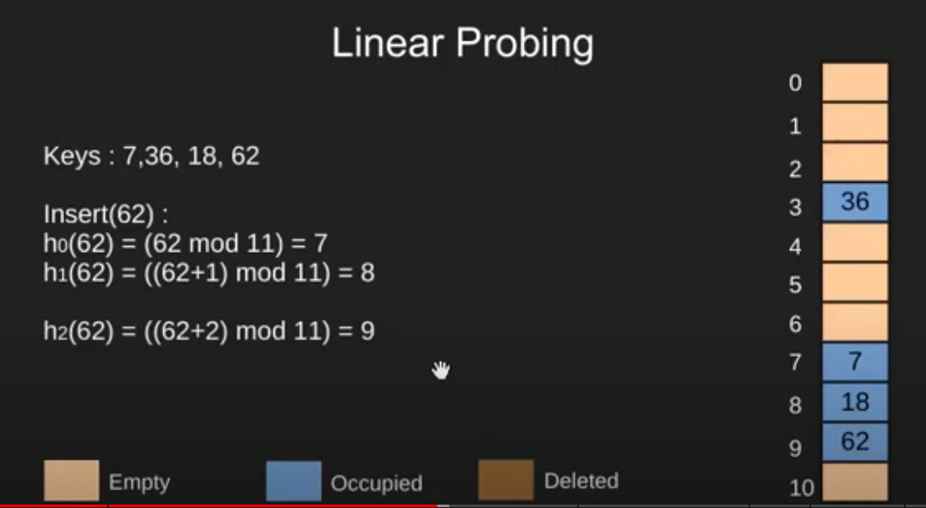
Linear Probing

Slide 22
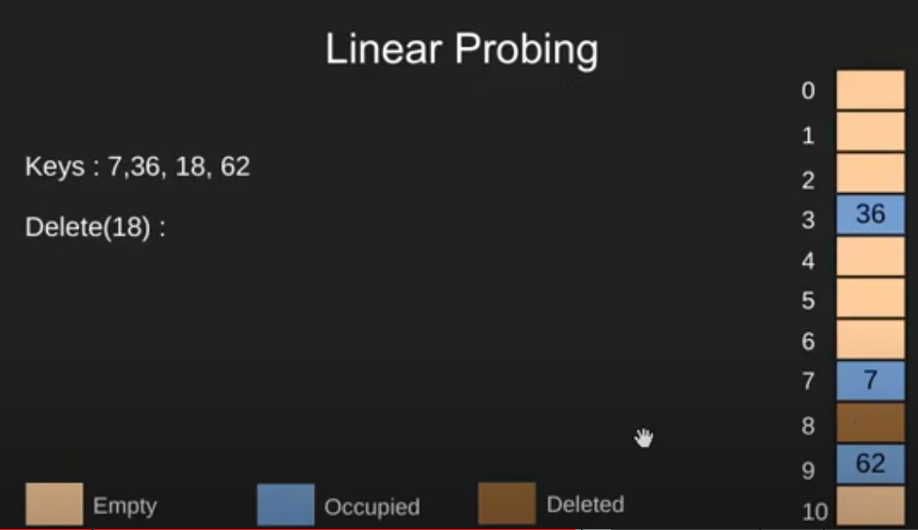
Linear Probing

